Slide 1
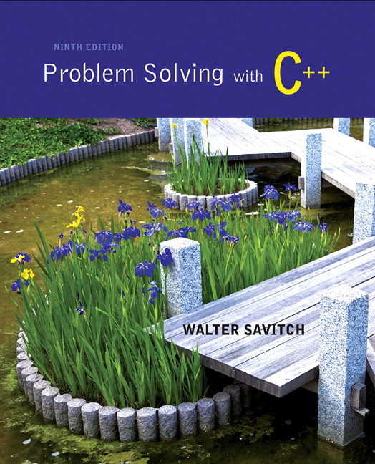
Problem Solving with C++ by Walter Savitch

Slide 2
Chapter 2
C++ Basics

Slide 3
Overview
2.1 Variables and Assignments
2.2 Input and Output
2.3 Data Types and Expressions
2.4 Simple Flow of Control
2.5 Program Style

Slide 4
2.1
Variables and Assignments

Slide 5
Variables and Assignments
Variables are like small blackboards
We can write a number on them
We can change the number
We can erase the number
C++ variables are names for memory locations
We can write a value in them
We can change the value stored there
We cannot erase the memory location
Some value is always there
Display 2.1

Slide 6
Identifiers
Variables names are called identifiers
Choosing variable names
Use meaningful names that represent data to be stored
First character must be
a letter
the underscore character
Remaining characters must be
letters
numbers
underscore character

Slide 7
Keywords
Keywords (also called reserved words)
Are used by the C++ language
Must be used as they are defined in the programming language
Cannot be used as identifiers

Slide 8
Declaring Variables (Part 1)
Before use, variables must be declared
Tells the compiler the type of data to store Examples: int number_of_bars; double one_weight, total_weight;
int is an abbreviation for integer.
could store 3, 102, 3211, -456, etc.
number_of_bars is of type integer
double represents numbers with a fractional component
could store 1.34, 4.0, -345.6, etc.
one_weight and total_weight are both of type double

Slide 9
Declaring Variables (Part 2)
Immediately prior to use
int main() { … int sum; sum = score1 + score 2; … return 0;
}
Two locations for variable declarations
At the beginning int main() { int sum; … sum = score1 + score2;
… return 0; }

Slide 10
Declaring Variables (Part 3)
Declaration syntax:
Type_name Variable_1 , Variable_2, . . . ;
Declaration Examples:
double average, m_score, total_score;
double moon_distance;
int age, num_students;
int cars_waiting;

Slide 11
Assignment Statements
An assignment statement changes the value of a variable
total_weight = one_weight + number_of_bars;
total_weight is set to the sum one_weight + number_of_bars
Assignment statements end with a semi-colon
The single variable to be changed is always on the left of the assignment operator ‘=‘
On the right of the assignment operator can be
Constants -- age = 21;
Variables -- my_cost = your_cost;
Expressions -- circumference = diameter * 3.14159;

Slide 12
Assignment Statements and Algebra
The ‘=‘ operator in C++ is not an equal sign
The following statement cannot be true in algebra
number_of_bars = number_of_bars + 3;
In C++ it means the new value of number_of_bars is the previous value of number_of_bars plus 3

Slide 13
Initializing Variables
Declaring a variable does not give it a value
Giving a variable its first value is initializing the variable
Variables are initialized in assignment statements double mpg; // declare the variable mpg = 26.3; // initialize the variable
Declaration and initialization can be combined using two methods
Method 1 double mpg = 26.3, area = 0.0 , volume;
Method 2 double mpg(26.3), area(0.0), volume;

Slide 14
Section 2.1 Conclusion
Can you
Declare and initialize two integers variables to zero? The variables are named feet and inches.
Declare and initialize two variables, one int and one double? Both should be initialized to the appropriate form of 5.
Give good variable names for identifiers to store
the speed of an automobile?
an hourly pay rate?
the highest score on an exam?

Slide 15
2.2
Input and Output

Slide 16
Input and Output
A data stream is a sequence of data
Typically in the form of characters or numbers
An input stream is data for the program to use
Typically originates
at the keyboard
at a file
An output stream is the program’s output
Destination is typically
the monitor
a file

Slide 17
Output using cout
cout is an output stream sending data to the monitor
The insertion operator "<<" inserts data into cout
Example: cout << number_of_bars << " candy bars\n";
This line sends two items to the monitor
The value of number_of_bars
The quoted string of characters " candy bars\n"
Notice the space before the ‘c’ in candy
The ‘\n’ causes a new line to be started following the ‘s’ in bars
A new insertion operator is used for each item of output

Slide 18
Examples Using cout
This produces the same result as the previous sample cout << number_of_bars ; cout << " candy bars\n";
Here arithmetic is performed in the cout statement cout << "Total cost is $" << (price + tax);
Quoted strings are enclosed in double quotes ("Walter")
Don’t use two single quotes (')
A blank space can also be inserted with cout << " " ; if there are no strings in which a space is desired as in " candy bars\n"

Slide 19
Include Directives
Include Directives add library files to our programs
To make the definitions of the cin and cout available to the program: #include <iostream>
Using Directives include a collection of defined names
To make the names cin and cout available to our program: using namespace std;

Slide 20
Escape Sequences
Escape sequences tell the compiler to treat characters in a special way
'\' is the escape character
To create a newline in output use \n – cout << "\n"; or the newer alternative cout << endl;
Other escape sequences: \t -- a tab \\ -- a backslash character \" -- a quote character

Slide 21
Formatting Real Numbers
Real numbers (type double) produce a variety of outputs double price = 78.5; cout << "The price is $" << price << endl;
The output could be any of these: The price is $78.5 The price is $78.500000 The price is $7.850000e01
The most unlikely output is: The price is $78.50

Slide 22
Showing Decimal Places
cout includes tools to specify the output of type double
To specify fixed point notation
setf(ios::fixed)
To specify that the decimal point will always be shown
setf(ios::showpoint)
To specify that two decimal places will always be shown
precision(2)
Example: cout.setf(ios::fixed); cout.setf(ios::showpoint); cout.precision(2); cout << "The price is " << price << endl;

Slide 23
Input Using cin
cin is an input stream bringing data from the keyboard
The extraction operator (>>) removes data to be used
Example: cout << "Enter the number of bars in a package\n"; cout << " and the weight in ounces of one bar.\n"; cin >> number_of_bars; cin >> one_weight;
This code prompts the user to enter data then reads two data items from cin
The first value read is stored in number_of_bars
The second value read is stored in one_weight
Data is separated by spaces when entered

Slide 24
Reading Data From cin
Multiple data items are separated by spaces
Data is not read until the enter key is pressed
Allows user to make corrections
Example: cin >> v1 >> v2 >> v3;
Requires three space separated values
User might type 34 45 12 <enter key>

Slide 25
Designing Input and Output
Prompt the user for input that is desired
cout statements provide instructions cout << "Enter your age: "; cin >> age;
Notice the absence of a new line before using cin
Echo the input by displaying what was read
Gives the user a chance to verify data cout << age << " was entered." << endl;

Slide 26
Section 2.2 Conclusion
Can you
write an input statement to place a value in the variable the_number?
Write the output statement to prompt for the value to store in the_number?
Write an output statement that produces a newline?
Format output of rational numbers to show 4 decimal places?

Slide 27
2.3
Data Types and Expressions

Slide 28
Data Types and Expressions
2 and 2.0 are not the same number
A whole number such as 2 is of type int
A real number such as 2.0 is of type double
Numbers of type int are stored as exact values
Numbers of type double may be stored as approximate values due to limitations on number of significant digits that can be represented

Slide 29
Writing Integer constants
Type int does not contain decimal points
Examples: 34 45 1 89

Slide 30
Writing Double Constants
Type double can be written in two ways
Simple form must include a decimal point
Examples: 34.1 23.0034 1.0 89.9
Floating Point Notation (Scientific Notation)
Examples: 3.41e1 means 34.1 3.67e17 means 367000000000000000.0 5.89e-6 means 0.00000589
Number left of e does not require a decimal point
Exponent cannot contain a decimal point

Slide 31
Other Number Types
Various number types have different memory requirements
More precision requires more bytes of memory
Very large numbers require more bytes of memory
Very small numbers require more bytes of memory
Display 2.2

Slide 32
Integer types
long or long int (often 4 bytes)
Equivalent forms to declare very large integers long big_total; long int big_total;
short or short int (often 2 bytes)
Equivalent forms to declare smaller integers short small_total; short int small_total;

Slide 33
Floating point types
long double (often 10 bytes)
Declares floating point numbers with up to 19 significant digits long double big_number;
float (often 4 bytes)
Declares floating point numbers with up to 7 significant digits float not_so_big_number;

Slide 34
Type char
Computers process character data too
char
Short for character
Can be any single character from the keyboard
To declare a variable of type char:
char letter;

Slide 35
char constants
Character constants are enclosed in single quotes char letter = 'a';
Strings of characters, even if only one character is enclosed in double quotes
"a" is a string of characters containing one character
'a' is a value of type character

Slide 36
C++11 Types
The size of numeric data types can vary from one machine to another.
For example, an int might be 32 bits or 64 bits
C++11 introduced new integer types that specify exactly the size and whether or not the data type is signed or unsigned
C++11 also has an “auto” type that deduces the type of the variable based on the expression on the right hand side of the assignment
auto x = 2.4 * 10; // x becomes a double due to 2.4
Display 2.3

Slide 37
Reading Character Data
cin skips blanks and line breaks looking for data
The following reads two characters but skips any space that might be between char symbol1, symbol2; cin >> symbol1 >> symbol2;
User normally separate data items by spaces J D
Results are the same if the data is not separated by spaces JD
Display 2.4

Slide 38
Type string
string is a class, different from the primitive data types discussed so far
Difference is discussed in Chapter 8
Use double quotes around the text to store into the string variable
Requires the following be added to the top of your program:
#include <string>
To declare a variable of type string: string name = "Apu Nahasapeemapetilon";
Display 2.5

Slide 39
Type Compatibilities
In general store values in variables of the same type
This is a type mismatch: int int_variable; int_variable = 2.99;
If your compiler allows this, int_variable will most likely contain the value 2, not 2.99

Slide 40
int ←→ double (part 1)
Variables of type double should not be assigned to variables of type int int int_variable; double double_variable; double_variable = 2.00; int_variable = double_variable;
If allowed, int_variable contains 2, not 2.00

Slide 41
int ←→ double (part 2)
Integer values can normally be stored in variables of type double double double_variable; double_variable = 2;
double_variable will contain 2.0

Slide 42
char ← → int
The following actions are possible but generally not recommended!
It is possible to store char values in integer variables int value = 'A'; value will contain an integer representing 'A'
It is possible to store int values in char variables char letter = 65;

Slide 43
bool ← → int
The following actions are possible but generally not recommended!
Values of type bool can be assigned to int variables
True is stored as 1
False is stored as 0
Values of type int can be assigned to bool variables
Any non-zero integer is stored as true
Zero is stored as false

Slide 44
Arithmetic
Arithmetic is performed with operators
+ for addition
- for subtraction
* for multiplication
/ for division
Example: storing a product in the variable total_weight total_weight = one_weight * number_of_bars;

Slide 45
Results of Operators
Arithmetic operators can be used with any numeric type
An operand is a number or variable used by the operator
Result of an operator depends on the types of operands
If both operands are int, the result is int
If one or both operands are double, the result is double

Slide 46
Division of Doubles
Division with at least one operator of type double produces the expected results. double divisor, dividend, quotient; divisor = 3; dividend = 5; quotient = dividend / divisor;
quotient = 1.6666…
Result is the same if either dividend or divisor is of type int

Slide 47
Division of Integers
Be careful with the division operator!
int / int produces an integer result (true for variables or numeric constants) int dividend, divisor, quotient; dividend = 5; divisor = 3; quotient = dividend / divisor;
The value of quotient is 1, not 1.666…
Integer division does not round the result, the fractional part is discarded!

Slide 48
Integer Remainders
% operator gives the remainder from integer division
int dividend, divisor, remainder; dividend = 5; divisor = 3; remainder = dividend % divisor; The value of remainder is 2
Display 2.6

Slide 49
Arithmetic Expressions
Use spacing to make expressions readable
Which is easier to read? x+y*z or x + y * z
Precedence rules for operators are the same as used in your algebra classes
Use parentheses to alter the order of operations x + y * z ( y is multiplied by z first) (x + y) * z ( x and y are added first)
Display 2.7

Slide 50
Operator Shorthand
Some expressions occur so often that C++ contains to shorthand operators for them
All arithmetic operators can be used this way
+= count = count + 2; becomes count += 2;
*= bonus = bonus * 2; becomes bonus *= 2;
/= time = time / rush_factor; becomes time /= rush_factor;
%= remainder = remainder % (cnt1+ cnt2); becomes remainder %= (cnt1 + cnt2);

Slide 51
2.4
Simple Flow of Control

Slide 52
Simple Flow of Control
Flow of control
The order in which statements are executed
Branch
Lets program choose between two alternatives

Slide 53
Branch Example
To calculate hourly wages there are two choices
Regular time ( up to 40 hours)
gross_pay = rate * hours;
Overtime ( over 40 hours)
gross_pay = rate * 40 + 1.5 * rate * (hours - 40);
The program must choose which of these expressions to use

Slide 54
Designing the Branch
Decide if (hours >40) is true
If it is true, then use gross_pay = rate * 40 + 1.5 * rate * (hours - 40);
If it is not true, then use gross_pay = rate * hours;

Slide 55
Implementing the Branch
if-else statement is used in C++ to perform a branch
if (hours > 40) gross_pay = rate * 40 + 1.5 * rate * (hours - 40);
else
gross_pay = rate * hours;
Display 2.8
Display 2.9

Slide 56
Boolean Expressions
Boolean expressions are expressions that are either true or false
comparison operators such as '>' (greater than) are used to compare variables and/or numbers
(hours > 40) Including the parentheses, is the boolean expression from the wages example
A few of the comparison operators that use two symbols (No spaces allowed between the symbols!)
>= greater than or equal to
!= not equal or inequality
= = equal or equivalent
Display 2.10

Slide 57
if-else Flow Control (1)
if (boolean expression) true statement else false statement
When the boolean expression is true
Only the true statement is executed
When the boolean expression is false
Only the false statement is executed

Slide 58
if-else Flow Control (2)
if (boolean expression) { true statements } else {
false statements }
When the boolean expression is true
Only the true statements enclosed in { } are executed
When the boolean expression is false
Only the false statements enclosed in { } are executed

Slide 59
AND
Boolean expressions can be combined into more complex expressions with
&& -- The AND operator
True if both expressions are true
Syntax: (Comparison_1) && (Comparison_2)
Example: if ( (2 < x) && (x < 7) )
True only if x is between 2 and 7
Inside parentheses are optional but enhance meaning

Slide 60
OR
| | -- The OR operator (no space!)
True if either or both expressions are true
Syntax: (Comparison_1) | | (Comparison_2)
Example: if ( ( x = = 1) | | ( x = = y) )
True if x contains 1
True if x contains the same value as y
True if both comparisons are true

Slide 61
NOT
! -- negates any boolean expression
!( x < y)
True if x is NOT less than y
!(x = = y)
True if x is NOT equal to y
! Operator can make expressions difficult to understand…use only when appropriate

Slide 62
Inequalities
Be careful translating inequalities to C++
if x < y < z translates as if ( ( x < y ) && ( y < z ) ) NOT if ( x < y < z )

Slide 63
Pitfall: Using = or ==
' = ' is the assignment operator
Used to assign values to variables
Example: x = 3;
'= = ' is the equality operator
Used to compare values
Example: if ( x == 3)
The compiler will accept this error: if (x = 3) but stores 3 in x instead of comparing x and 3
Since the result is 3 (non-zero), the expression is true

Slide 64
Compound Statements
A compound statement is more than one statement enclosed in { }
Branches of if-else statements often need to execute more that one statement
Example: if (boolean expression) { true statements } else {
false statements }
Display 2.11

Slide 65
Branches Conclusion
Can you
Write an if-else statement that outputs the word High if the value of the variable score is greater than 100 and Low if the value of score is at most 100? The variables are of type int.
Write an if-else statement that outputs the word Warning provided that either the value of the variable temperature is greater than or equal to 100, or the of the variable pressure is greater than or equal to 200, or both. Otherwise, the if_else sttement outputs the word OK. The variables are of type int.

Slide 66
Simple Loops
When an action must be repeated, a loop is used
C++ includes several ways to create loops
We start with the while-loop
Example: while (count_down > 0) { cout << "Hello "; count_down -= 1; }
Output: Hello Hello Hello when count_down starts at 3
Display 2.12

Slide 67
While Loop Operation
First, the boolean expression is evaluated
If false, the program skips to the line following the while loop
If true, the body of the loop is executed
During execution, some item from the boolean expression is changed
After executing the loop body, the boolean expression is checked again repeating the process until the expression becomes false
A while loop might not execute at all if the boolean expression is false on the first check

Slide 68
while Loop Syntax
while (boolean expression is true) { statements to repeat }
Semi-colons are used only to end the statements within the loop
while (boolean expression is true) statement to repeat
Display 2.13

Slide 69
do-while loop
A variation of the while loop.
A do-while loop is always executed at least once
The body of the loop is first executed
The boolean expression is checked after the body has been executed
Syntax: do { statements to repeat } while (boolean_expression);
Display 2.14
Display 2.15

Slide 70
Increment/Decrement
Unary operators require only one operand
+ in front of a number such as +5
- in front of a number such as -5
++ increment operator
Adds 1 to the value of a variable x ++; is equivalent to x = x + 1;
-- decrement operator
Subtracts 1 from the value of a variable x --; is equivalent to x = x – 1;

Slide 71
Sample Program
Bank charge card balance of $50
2% per month interest
How many months without payments before your balance exceeds $100
After 1 month: $50 + 2% of $50 = $51
After 2 months: $51 + 2% of $51 = $52.02
After 3 months: $52.02 + 2% of $52.02 …
Display 2.16

Slide 72
Infinite Loops
Loops that never stop are infinite loops
The loop body should contain a line that will eventually cause the boolean expression to become false
Example: Print the odd numbers less than 12 x = 1; while (x != 12) { cout << x << endl; x = x + 2; }
Better to use this comparison: while ( x < 12)

Slide 73
Section 2.4 Conclusion
Can you
Show the output of this code if x is of type int? x = 10; while ( x > 0) { cout << x << endl; x = x – 3; }
Show the output of the previous code using the comparison x < 0 instead of x > 0?

Slide 74
2.5
Program Style

Slide 75
Program Style
A program written with attention to style
is easier to read
easier to correct
easier to change

Slide 76
Program Style - Indenting
Items considered a group should look like a group
Skip lines between logical groups of statements
Indent statements within statements if (x = = 0) statement;
Braces {} create groups
Indent within braces to make the group clear
Braces placed on separate lines are easier to locate

Slide 77
Program Style - Comments
// is the symbol for a single line comment
Comments are explanatory notes for the programmer
All text on the line following // is ignored by the compiler
Example: //calculate regular wages gross_pay = rate * hours;
/* and */ enclose multiple line comments
Example: /* This is a comment that spans multiple lines without a comment symbol on the middle line */

Slide 78
Program Style - Constants
Number constants have no mnemonic value
Number constants used throughout a program are difficult to find and change when needed
Constants
Allow us to name number constants so they have meaning
Allow us to change all occurrences simply by changing the value of the constant

Slide 79
Constants
const is the keyword to declare a constant
Example: const int WINDOW_COUNT = 10; declares a constant named WINDOW_COUNT
Its value cannot be changed by the program like a variable
It is common to name constants with all capitals
Display 2.17

Slide 80
Section 2.5 Conclusion
Can you
Create a named constant of type double?
Determine if a program can modify the value of a constant?
Describe the benefits of comments?
Explain why indenting is important in a program?
Explain why blank lines are important in a program?

Slide 81
Chapter 2 -- End

Slide 82
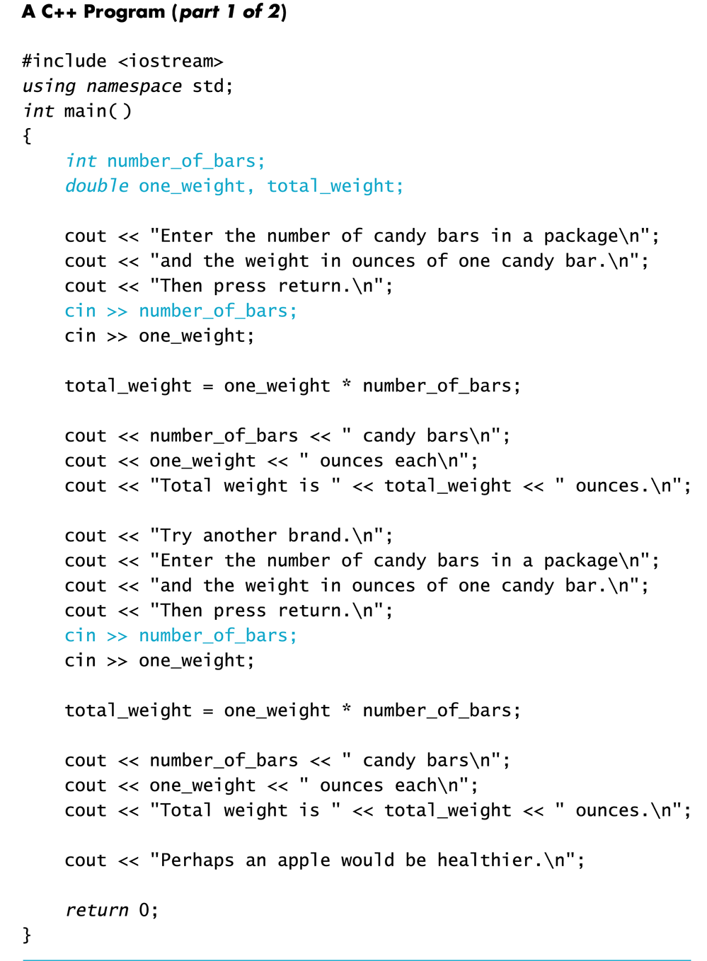
Display 2.1 (1/2)
Back
Next

Slide 83
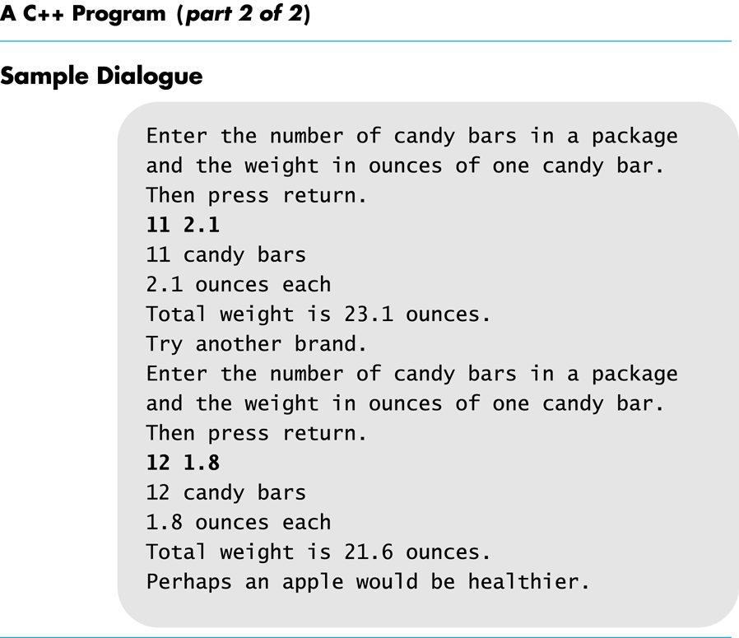
Display 2.1 (2 /2)
Back
Next

Slide 84
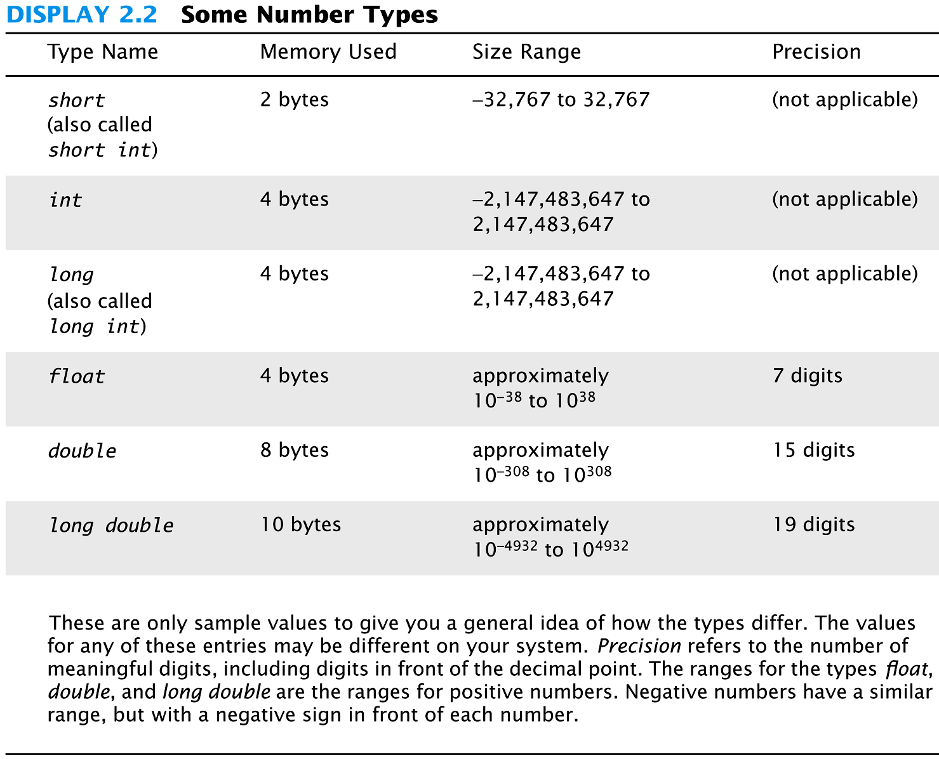
Display 2.2
Back
Next

Slide 85
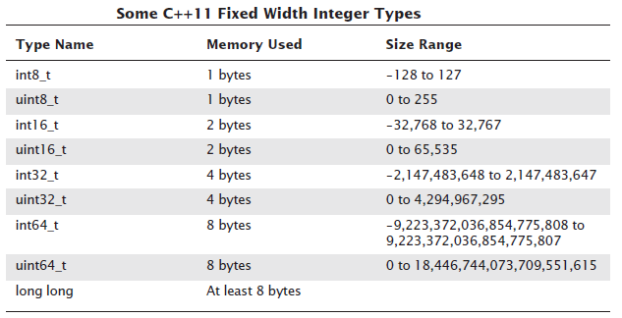
Display 2.3
Back
Next

Slide 86
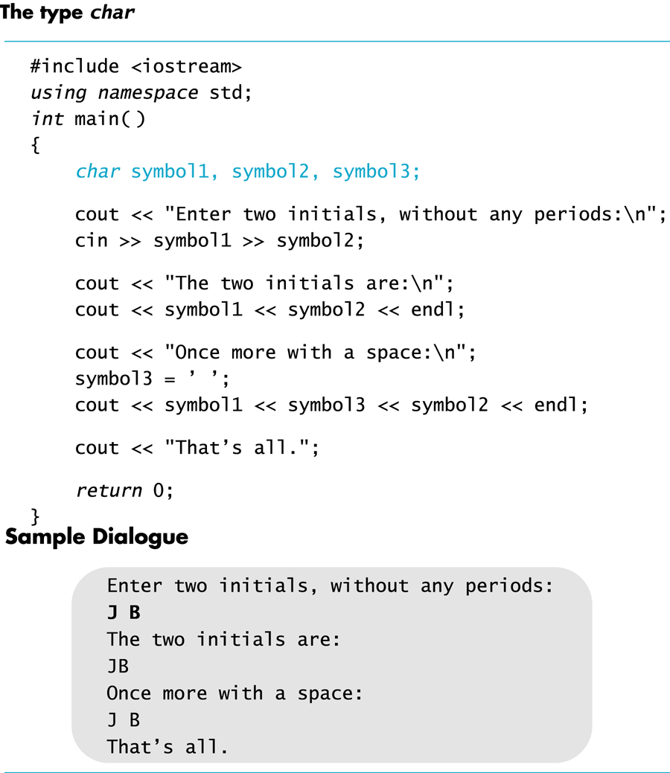
Display 2.4
Back
Next

Slide 87
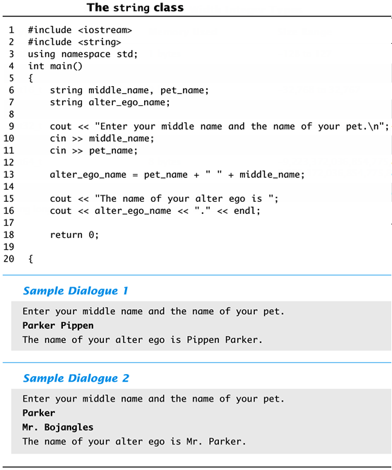
Display 2.5
Back
Next

Slide 88
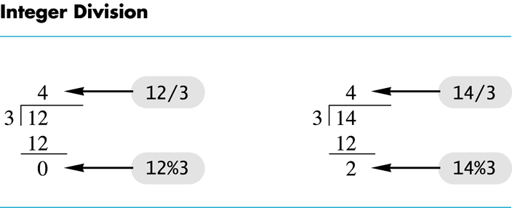
Display 2.6
Back
Next

Slide 89
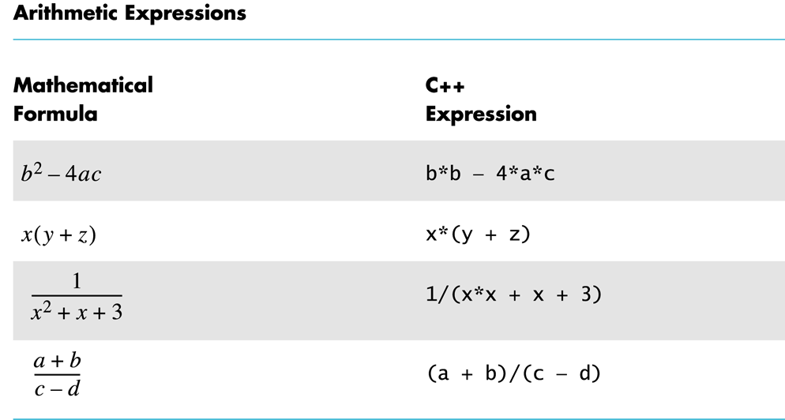
Display 2.7
Back
Next

Slide 90
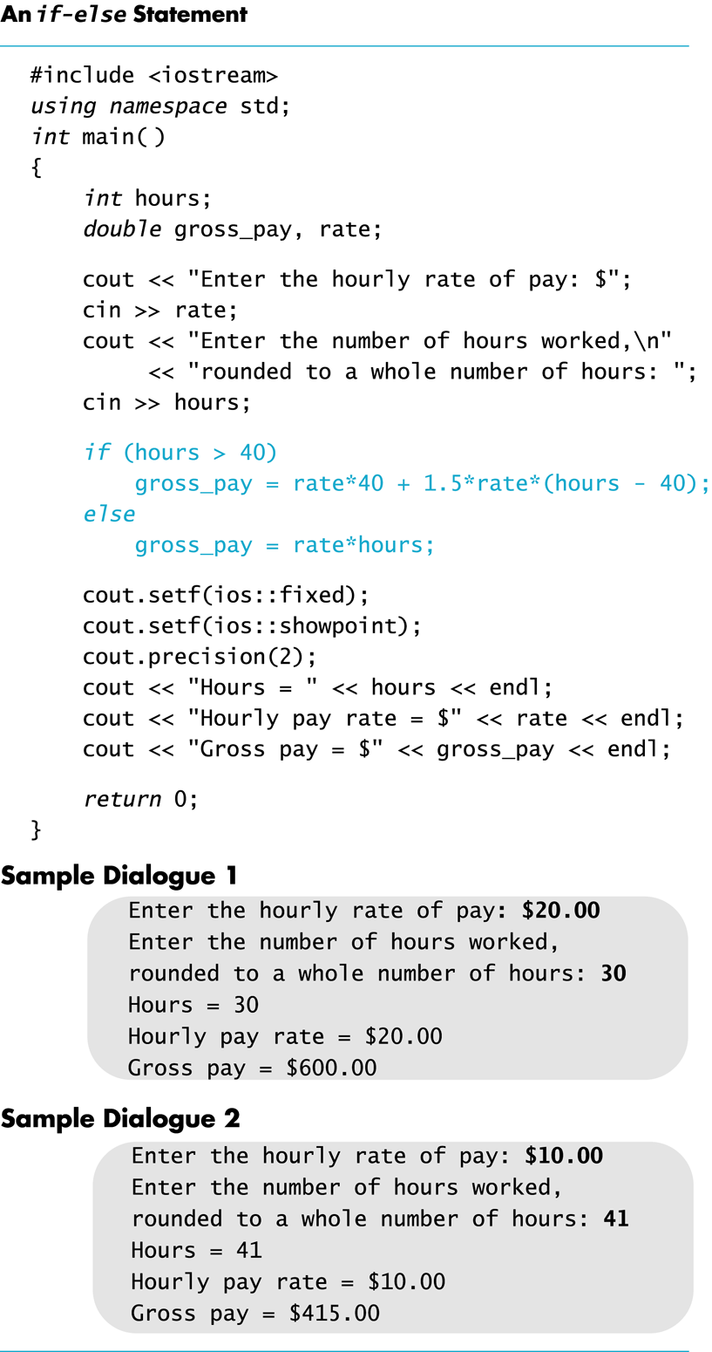
Display 2.8
Back
Next

Slide 91
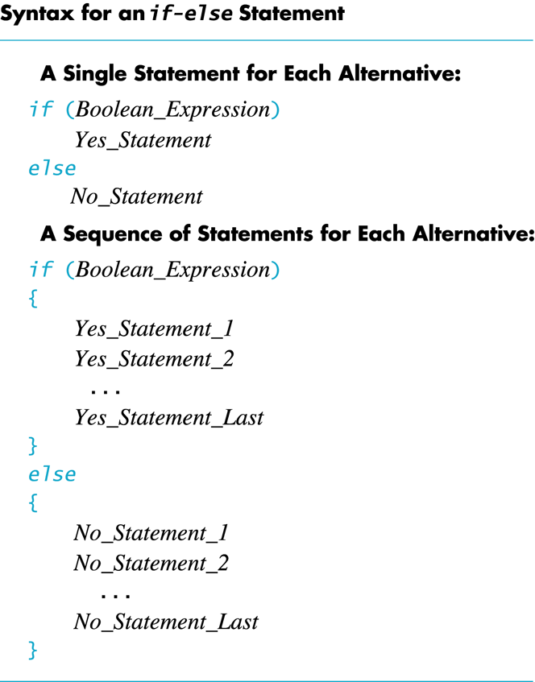
Display 2.9
Back
Next

Slide 92
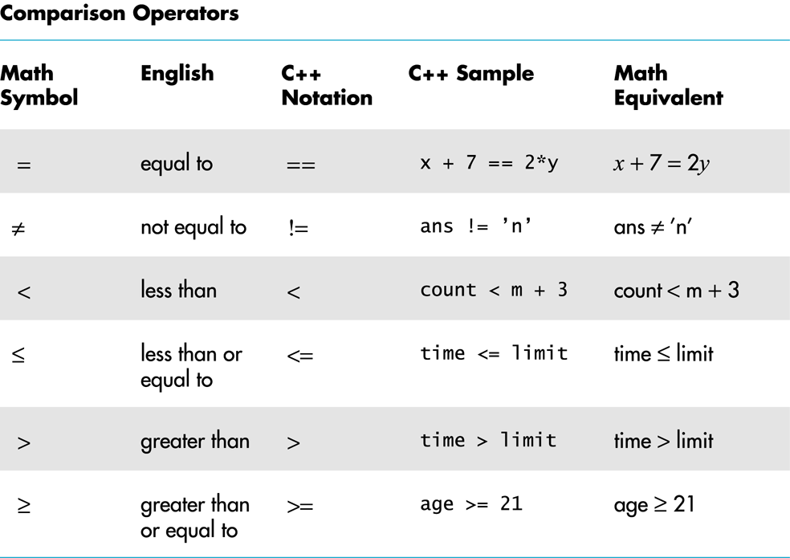
Display 2.10
Back
Next

Slide 93
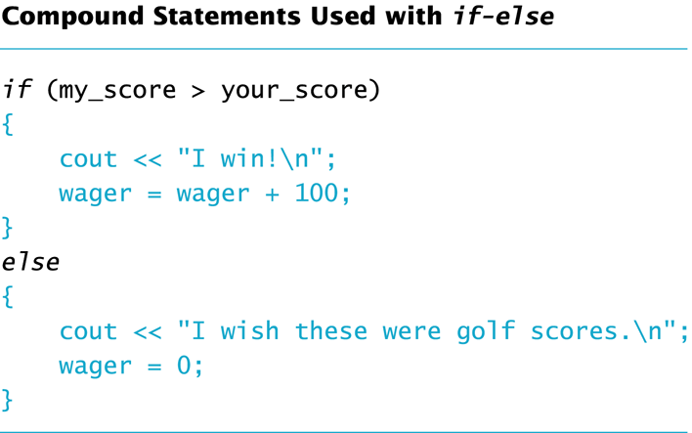
Display 2.11
Back
Next

Slide 94
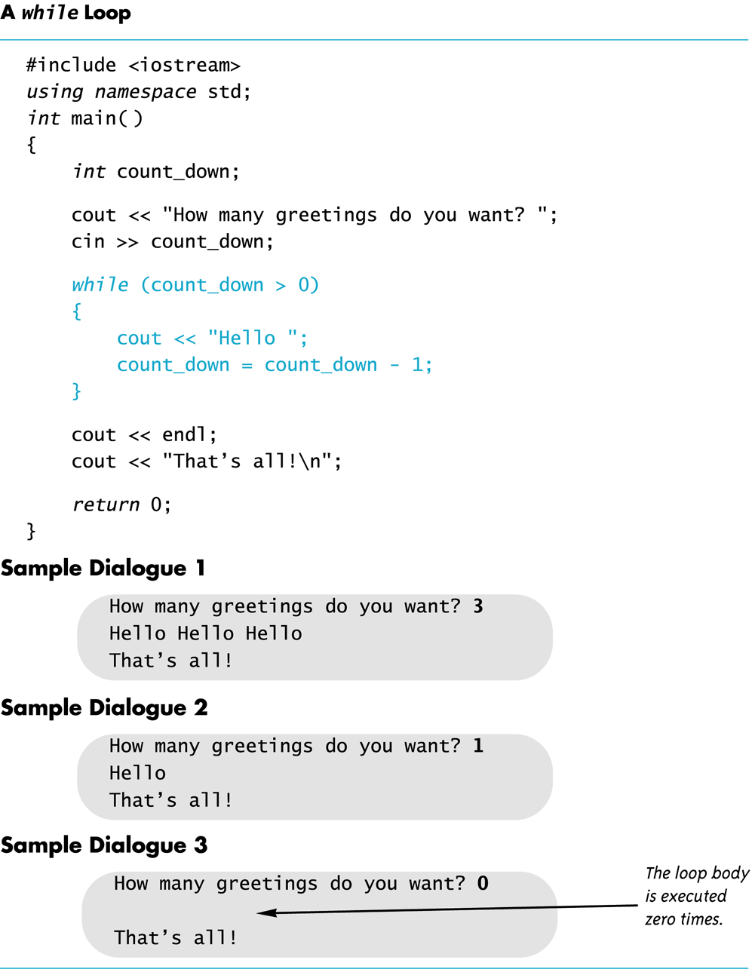
Display 2.12
Back
Next

Slide 95
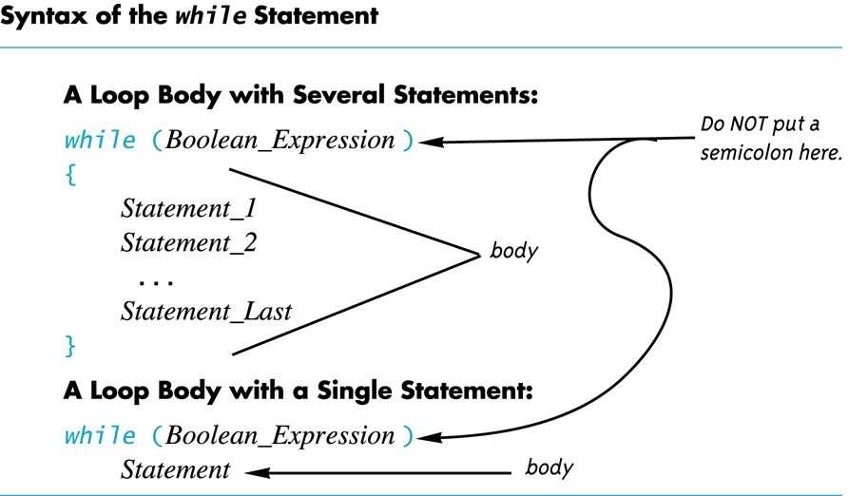
Display 2.13
Back
Next

Slide 96
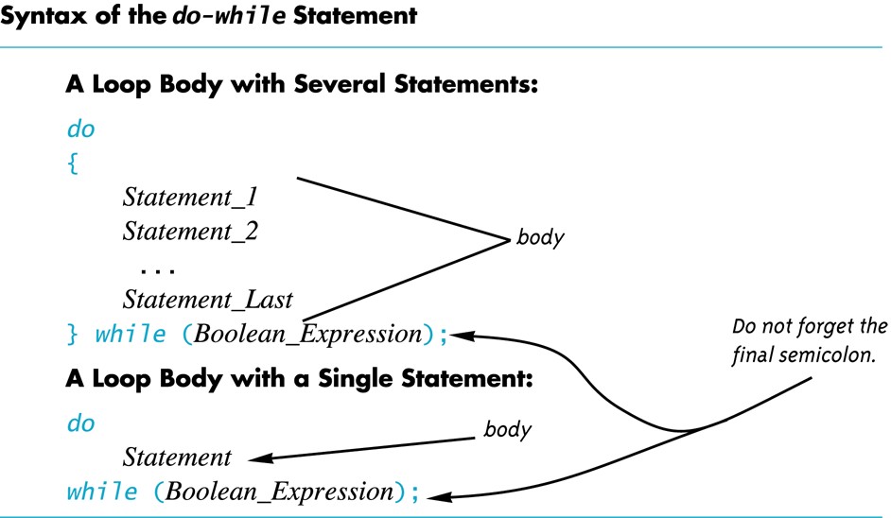
Display 2.14
Back
Next

Slide 97
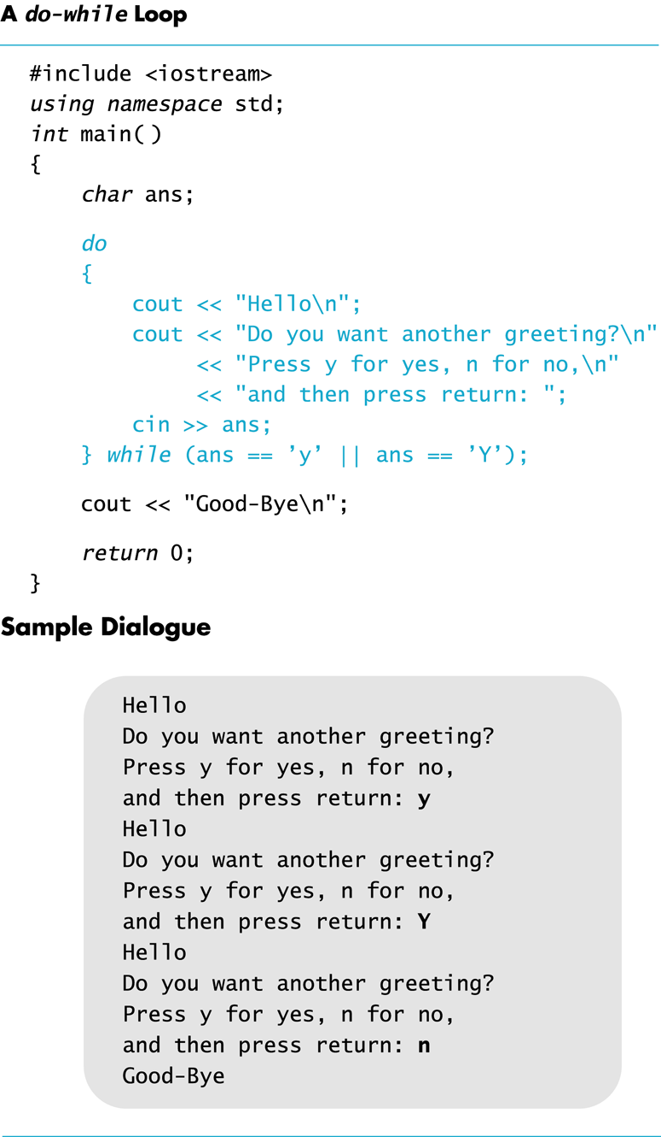
Display 2.15
Back
Next

Slide 98
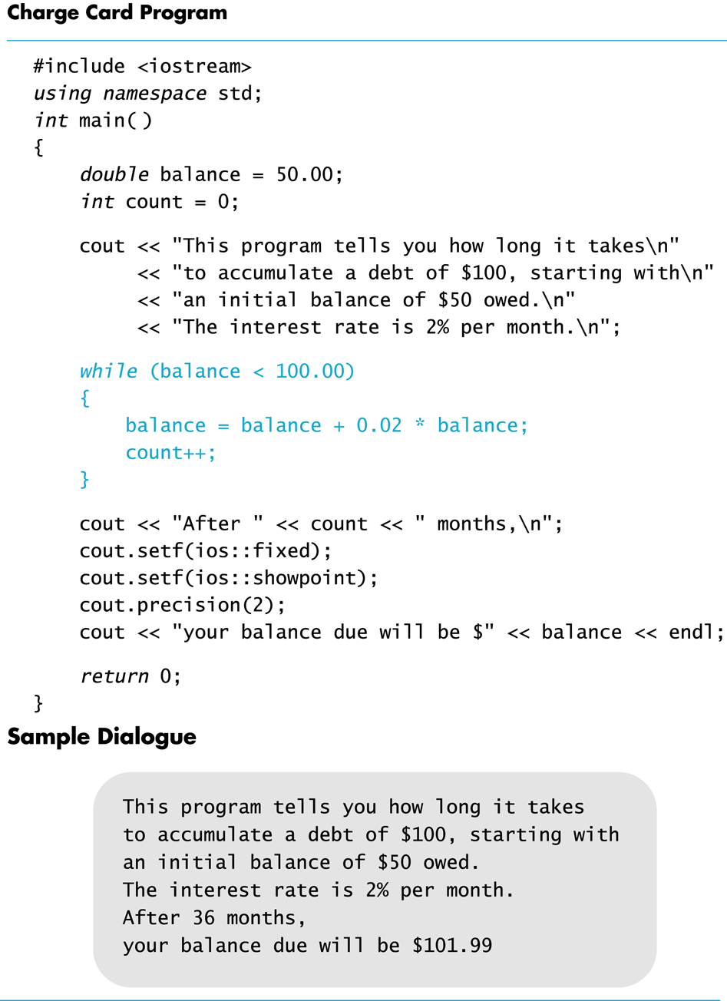
Display 2.16
Back
Next

Slide 99
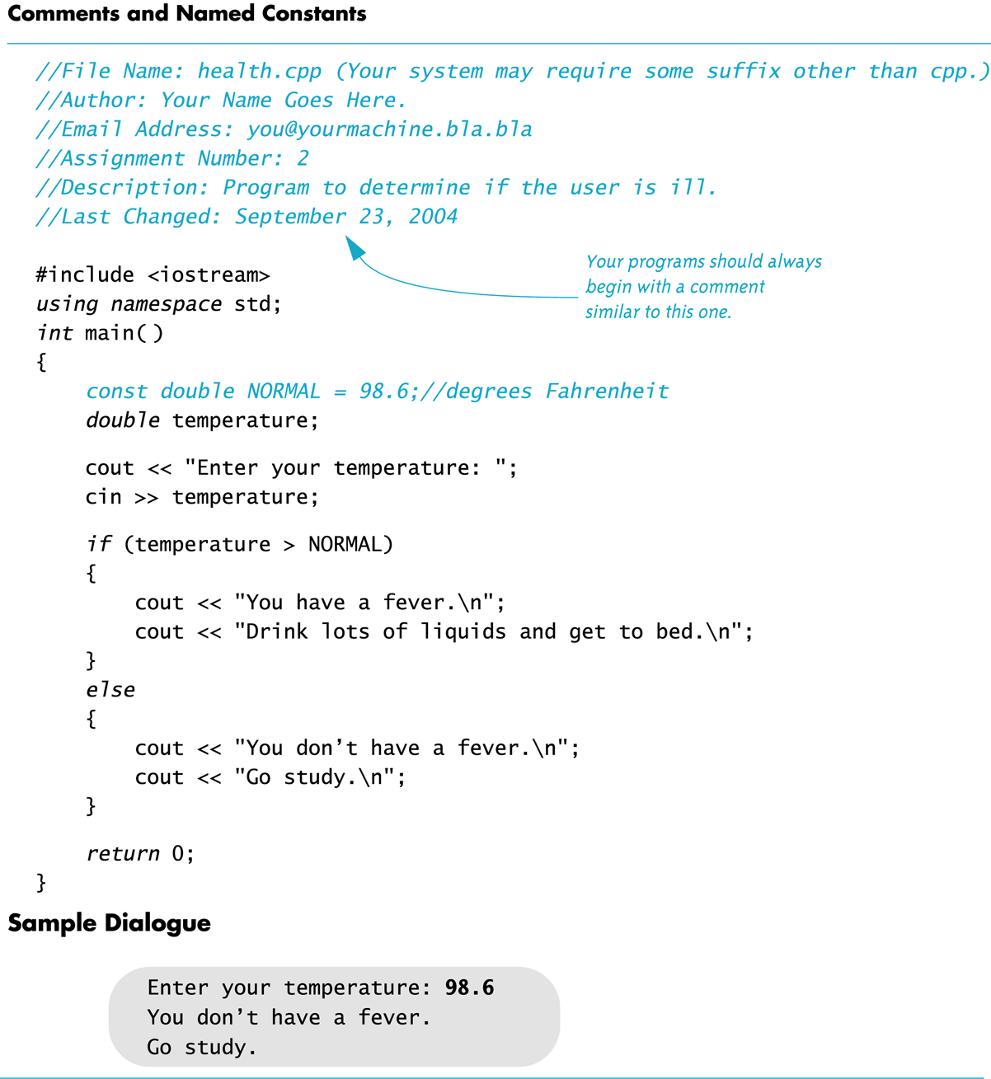
Display 2.17
Back
Next

